Slide 1
WELCOME TO
PYTHON WORKSHOP

Slide 2
TITLE
COOKIE BIRD GAME
TEAM NUMBER : 27
TEAM NAME : TRIPLE “S”
TEAM MEMBERS: SATHISH P
SELVAMANI P
SOWMYA S

Slide 3
MENTORS
TEAM MENTOR : Er .SATHIESH M.E,(PH.D).,
ACADEMIC MENTOR : Er.SATHISH M.E,(Ph.D).,
INDUSTRY MENTOR :
MS.SUBAASHINI U
ASSOCIATE
KGISL GSS

Slide 4
ABSTRACT
Title of my game is cookie bird game. The main aim of this game is to escape from the coming obstacles in the opposite direction. In this game only one player can play the game. In this game we need to move the bird upwards by using up arrow key. When the bird hits the obstacles then the game gets over. It is based on the high score

Slide 5
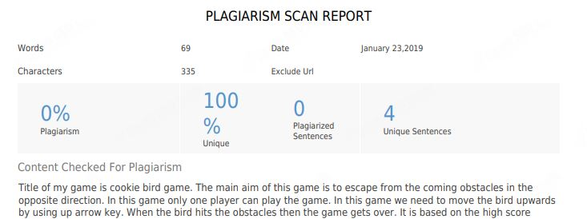
PLAGARISM REPORT

Slide 6
MODULES
ENTER THE GAME
START OPTION IS TO START THE GAME
UP ARROW KEY IS USED TO MOVE UPWARDS
UP ARROW KEY IS USED TO CONTROL THE BIRD
SPACE KEY IS USED TO RESTART THE GAME
SCORE WILL INCREASE BY ONE POINT BY ONE POINT FOR EACH CROSSING OF OBSTACLES
EXIT OPTION IS TO QUIT THE GAME

Slide 7
REQUIRMENT HARDWARE &SOFTWARE
THONNY
PYGAME

Slide 8
MODEL ARCHITECTURE
ENTER THE GAME
CHOOSE START OPTION TO START THE GAME
YOU HAVE TO PROTECT THE BIRD FROM THE UP COMING OBSTACLES
THE BIRD AUTOMATICALLY COMES DOWNWARDS, SO YOU WANT TO MOVE THE BIRD UPWARDS AND LET TO FLY
UP ARROW KEY IS USED TO MOVE THE BIRD UPWARDS
SCORE WILL INCREASE WHEN YOU CROSSING THE OBSTACLES
IF THE BIRD TOUCH ANY OBSTACLES THE GAME IS OVER

Slide 9
MODEL PROGRAM
import os
import sys
from distutils.core import setup
import py2exe
origIsSystemDLL = py2exe.build_exe.isSystemDLL
def isSystemDLL(pathname):
dlls = ("libfreetype-6.dll", "libogg-0.dll", "sdl_ttf.dll")
if os.path.basename(pathname).lower() in dlls:
return 0
return origIsSystemDLL(pathname)
py2exe.build_exe.isSystemDLL = isSystemDLL
sys.argv.append('py2exe')
setup(
name = 'cookie bird',
version = '1.0',
author = 'SourabhVerma',
options = {
'py2exe': {
'bundlefiles': 1, # doesn't work on win64
'compressed': True,
}
},

Slide 10
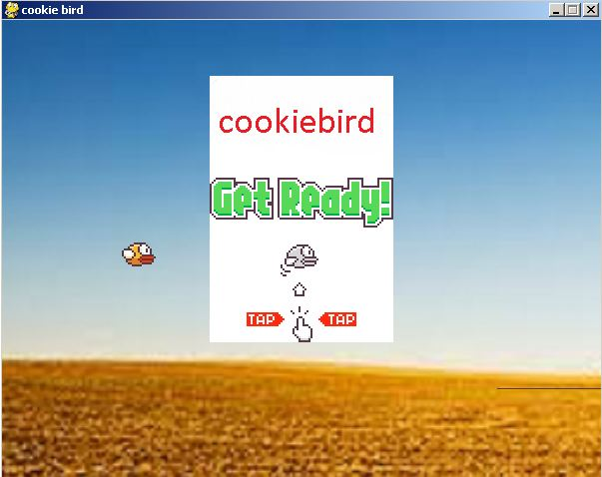
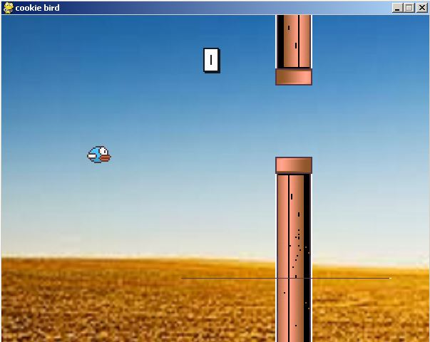
SCREEN SHOTS

Slide 11
CONCLUSION
Python code for a pygame is developed and the output is obtained successfully

